Slide 1
Team Status Report
Team Argus - 03/06/2015

Slide 2
Project Plan
Tracking through first set of development tasks
Cost Analysis
Planned Cost = 432 hours
Actual Cost = 390 hours
Earned Value = 403.5 hours
CPI = 1.03 (Change from 1.07)
SPI = .98 (Change from .95)

Slide 3
Phototransistor Research
Does our current phototransistor work?
Using Op Amps
Testing it with the table

Slide 4
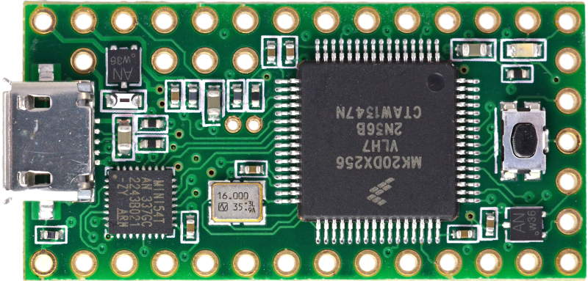
Hardware
Teensy Implementation
Teensy Limitations
185mA
3.3V Output (without VUSB)
100mA unpowered hub

Slide 5
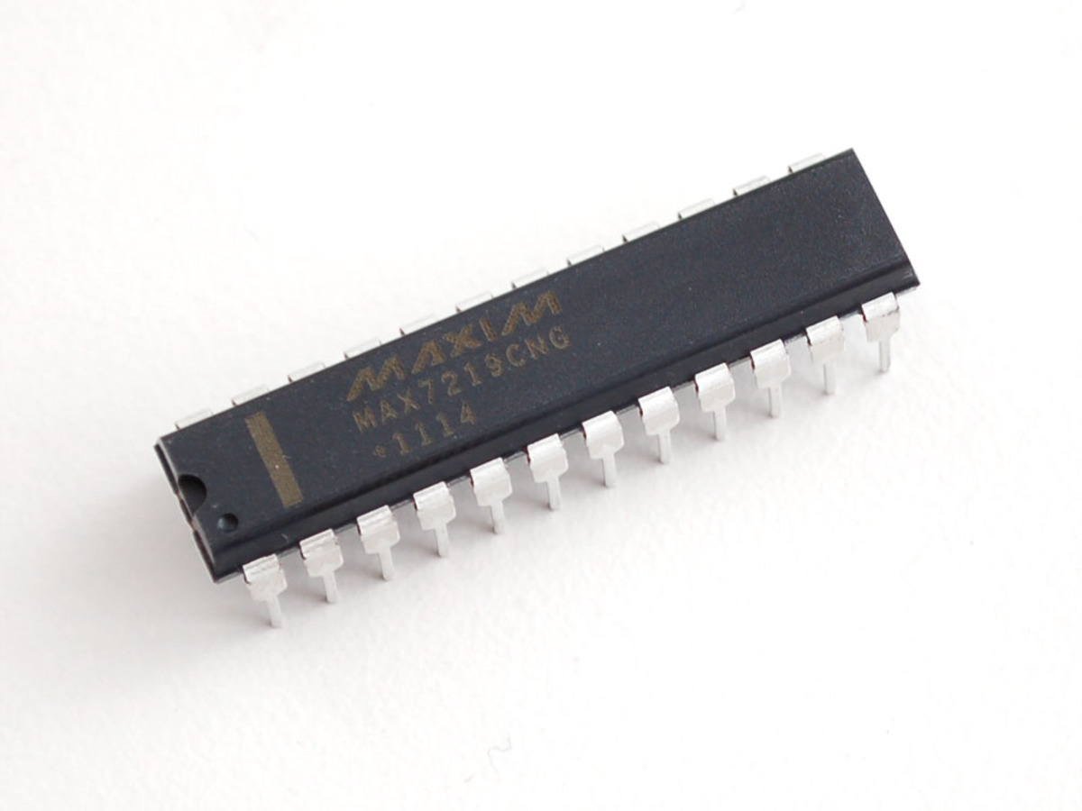
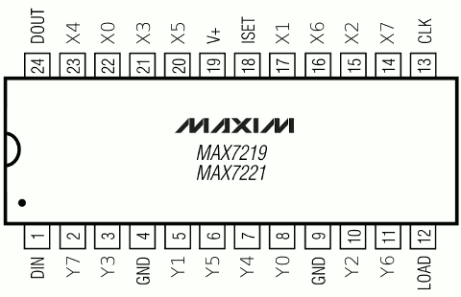
Hardware
MAX7219 LED Driver
⅛ Duty Cycle
Up to 8x8 LED array
Evenly distribute power
Overcurrent protection for board

Slide 6
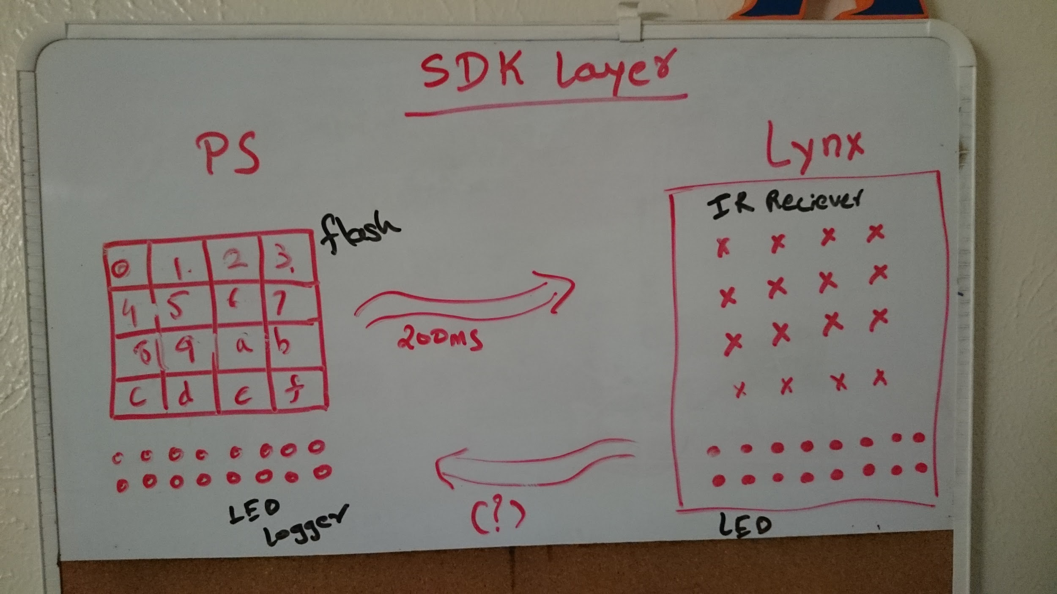
Test Application (PixelSense-SDK Layer)
Converts String to binary number
Flashes grid on screen depending on binary numbers (4 X 4 currently).
Similarly, logs the touch position and type.

Slide 7
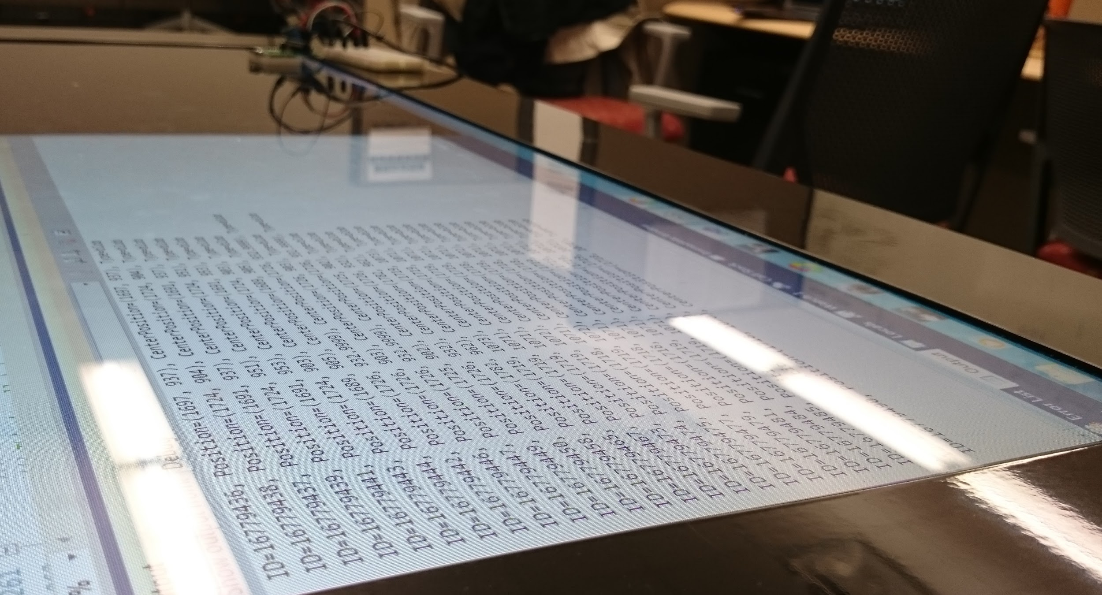
Test Application (PixelSense-SDK Layer)
Logs each touch input to the screen.
Plan for Spring Break:
Detect LED flashes
Test /play with distance between LEDs.
Make a fixed position on screen for data transfer.
Come up with a pattern or sequence of LEDs to initiate transfer.

Slide 8
Test Module Progress
Static class of functions (dataLogger, dataEmulator)
Simplicity through generic functions
PixelSense test modules nearly complete (needs testing)
Reconsider structure for printing byte arrays
Decisions to make on meta-data specific
Still necessary to port to android environment

Slide 9
Future Work
Pixelsense
Get Pixelsense to read led flashes
Android
Get Android data received from Lynx working 100%
Testing
Porting Test Modules.
Establish a bit header for byte arrays.
Start working on Test Plan

Slide 10
Questions?
Fun Fact #56
Zedd auditioned for a lead role in the ice skating musical “Frozen On Ice”...
...he did not get the part :0(

